Slide 1


Slide 2

Al-Biruni Gemstones Authenticator
FYP Defense Presentation By BSCS-S21-001
03-134181-008 | Jibran Ali
03-134181-021 | Muhammad Muzamil Rashid

Slide 3
Layout
Significance of Gemstones
Literature Review
Research Gap
Problem Statement
Aims and Objectives
Deliverable and Beneficiaries
Methodology
Implementations and Experiments
Results and Discussions
Conclusion and Future Work
Achievements

Slide 4
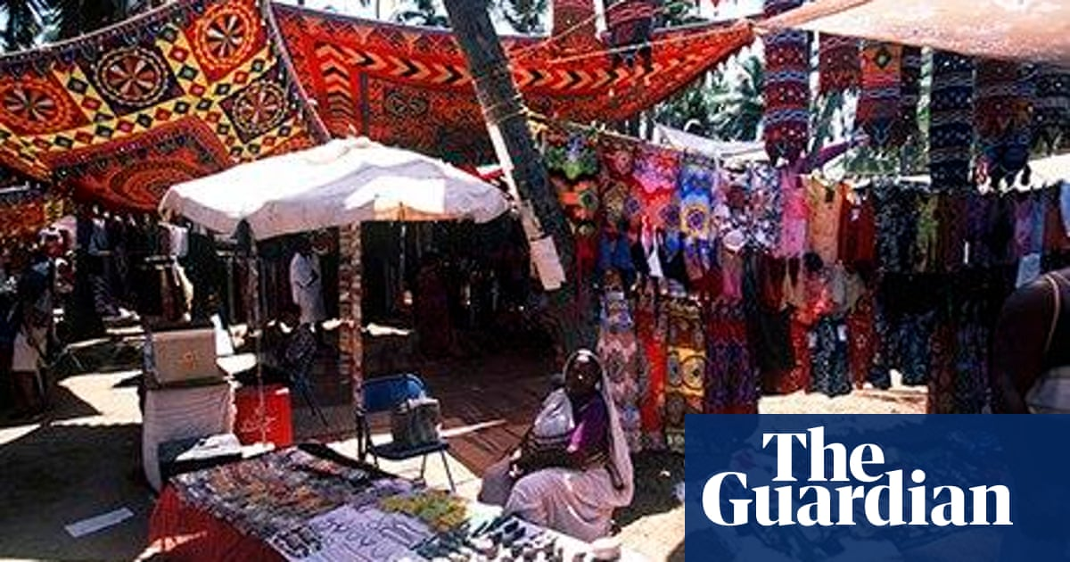
Significance of Gemstones
Gemstones are minerals, rocks or organic matters
Complex Nature
Scams
Gem scams in Goa, Turkey , Sri Lanka
Durban (300,000R) Scam
Emerald Scam in Africa

Slide 5
Literature Review
11 research papers reviewed
2 Streams–identification of gemstones using hardware, identification of gemstone using machine learning
5 were of hardware, 6 were of machine learning

Slide 6
Literature Review (Hardware)
Ref | Research Title | Stones | Techniques Use | Results
[6] 1987 | Infrared spectroscopy in gem identification. | Diamond, Crystal, Opals, Turquoise | Infrared spectroscopy | Fail
[7] 2011 | Powder diffraction analysis of gemstone inclusions | single crystal (such as diamonds), polycrystalline (such as lapis lazuli), or amorphous (such as amber) | Mo Kα radiation | Success
[4] 2016 | The Ring Monstrance from the Loreto treasury in Prague: Handheld Raman spectrometer for identification of gemstones | Diamond, Emerald, and sapphire | Raman spectrometer | Success
[5] 2019 | Geographic origin determination of emerald | Emerald | Inclusion and Spectroscopy | Fail
[8] 2020 | Gemstone identification using fluorescence technique | Ruby Crystal | fluorescence technique | Success

Slide 7
Literature Review (ML)
Ref | Research Title | Stones | Dataset | Techniques Use | Accuracy
[14] 2013 | Multiclass Amber Gemstones Classification with Various Segmentation and Committee Strategies | Amber | 11482 samples of 30 different classes of amber | Decision tree with half half method | 73.18%
[13] 2016 | Automated Opal Grading by Imaging and Statistical Learning | Opal | 865 samples for each kind of Opal | Image processing, classification, and regression techniques, flash histogram | 95.31%
[9] 2017 | Development of a Gemstone Type Identification System Based on HSV Space Colour Using an Artificial Neural Network Back Propagation Model | Ruby, Sapphire, and Emerald | 30 samples | Artificial Neural Network Back Propagation Algorithm | 90.66%
[12] 2017 | Amber Gemstones Sorting by Colour | Amber | 9,008 samples of 30 different classes of amber | Half method, random forest | 88.21%
[11] 2019 | Feasibility of gem identification using reflectance spectra coupled with artificial intelligence | almandine, turquoise, agate, plastic, glass, dyed, impregnated, and Zachery | 193 Samples | Artificial Neural Network | 93.81%
[10] 2020 | Classification of amber gemstone objects by shape | Amber | 2800 samples | Image Processing, Computer vision | 83.5

Slide 8
Research Gap
Research done on few common gemstones
No study on fake gemstones
Study done with low samples of dataset

Slide 9
Problem Statement
Proposed system will authenticate between real and fake gemstones of three kinds— Emerald, Ruby, Turquoise and Identify types of gemstones to make it easier for layman to distinguish between gemstone.

Slide 10
Aims and Objectives
To create a benchmark dataset
To create a system that identify common 3 stones (Turquoise, Ruby, Emerald)
To create a system that authenticate between real or fake gemstones of Turquoise, Ruby and Emerald
To improve the benchmark accuracy 90.66% and 93.81% achieved in [9] and [11] with large dataset

Slide 11
Deliverable and Beneficiaries
Following is the deliverable
Android Mobile application named Gemo
Following are the beneficiaries
Gemstone Buyers
Gemstone Sellers
Gemstone researchers

Slide 12
Methodology
Problem Statement
Benchmark Dataset Collection & Pre-Processing
Model Design
Application
Model Verification & Validation
Phase 1: Literature Review and Problem Statement
Phase 2: Benchmark Dataset Collection & Pre-Processing
Phase 3: Model Design & Model Verification and Validation
Phase 4: Development of Application (Proof of Concept)

Slide 13
Benchmark Dataset
Dataset is generated in two subphases
Dataset generation through market visits
Dataset generation through websites
Dataset generation through market visits
5 markets were visited
Nageena Market
Usman Jewellers Township Market
Basand Jewellers (Online Seller) Township Market
Kundan Jeweller International Market
Zeeshan Gems BOR Market
Total 4315 images were generated

Slide 14
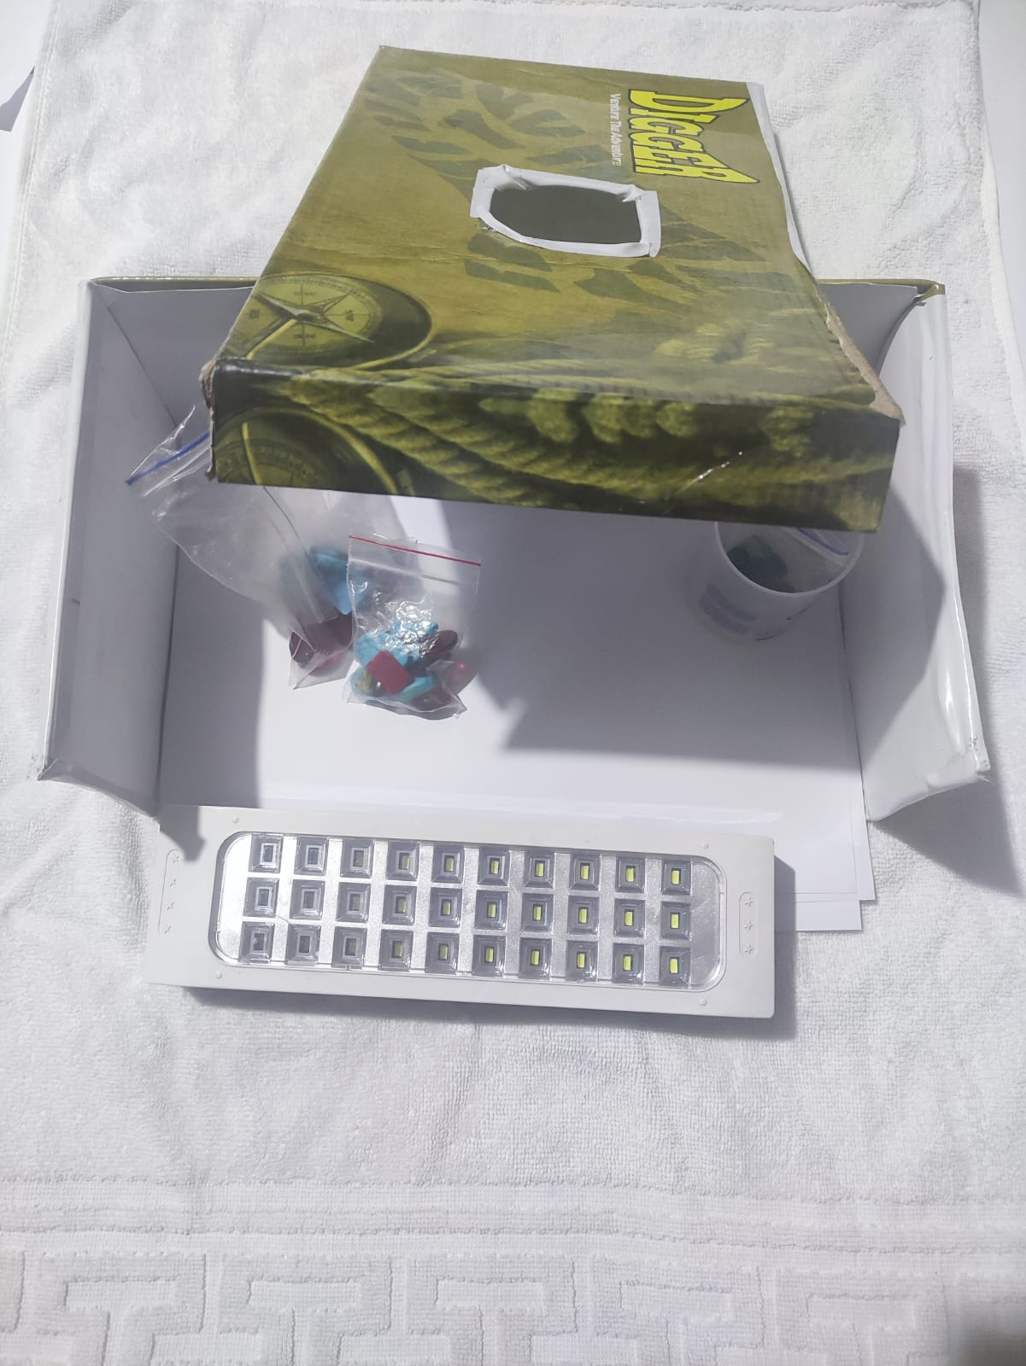
Controlled Environment Box
Handmade Environment created
Constancy in datasets
Avoid Reflection and shadows in the images

Slide 15
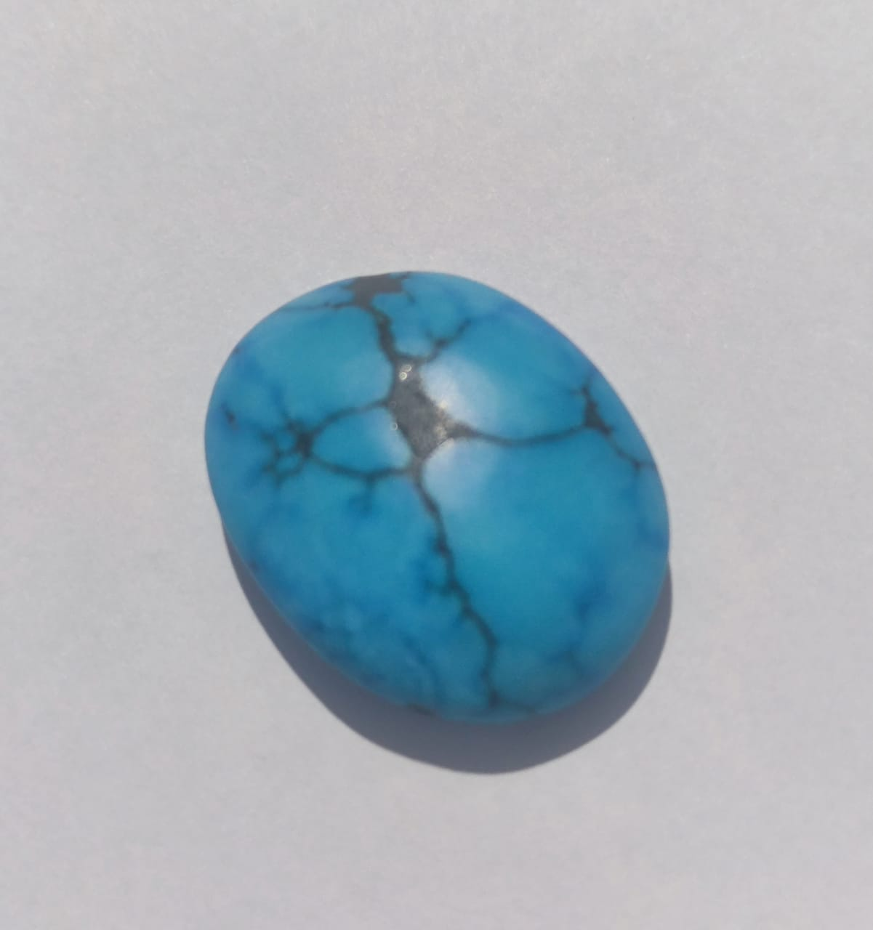
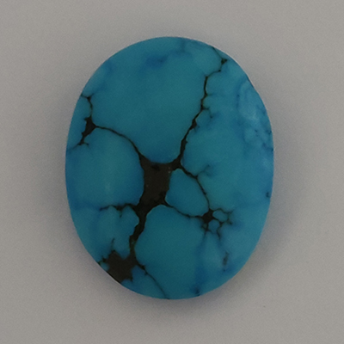

Controlled Environment Box Results
Reflection
Shadow
Before
After

Slide 16
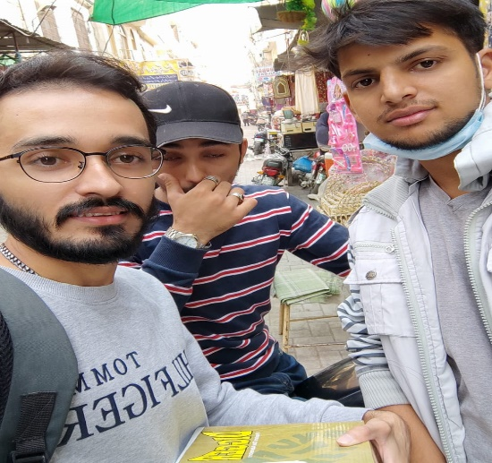
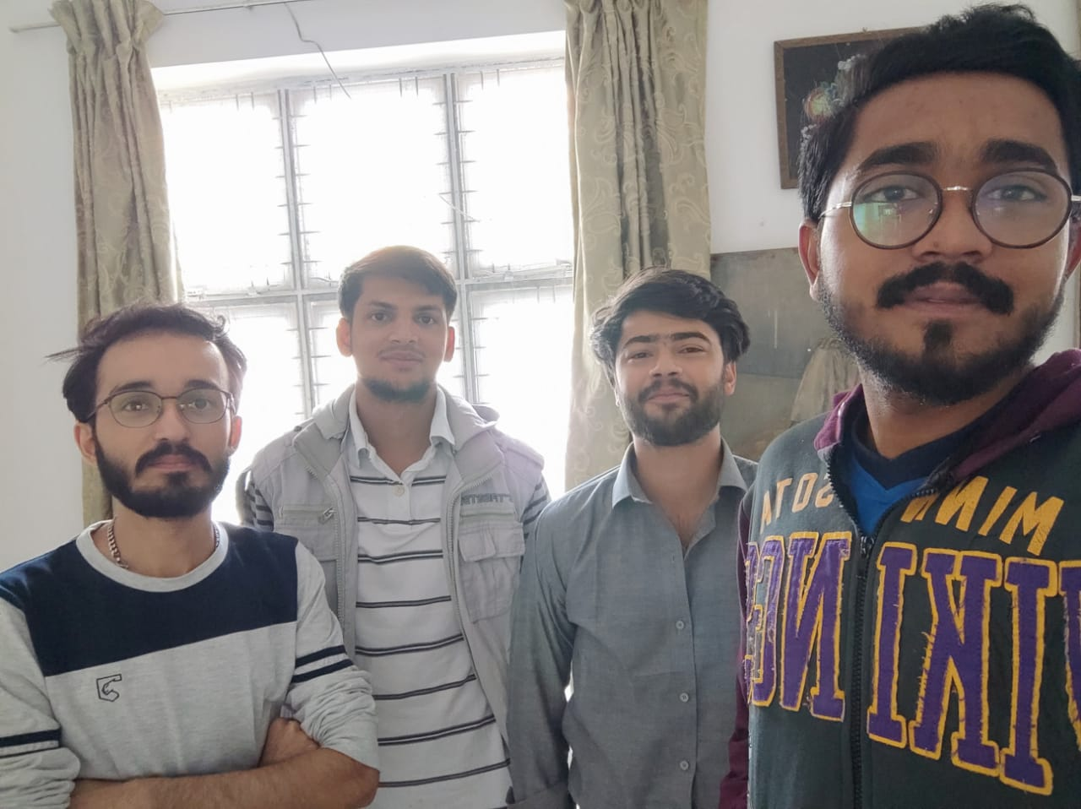
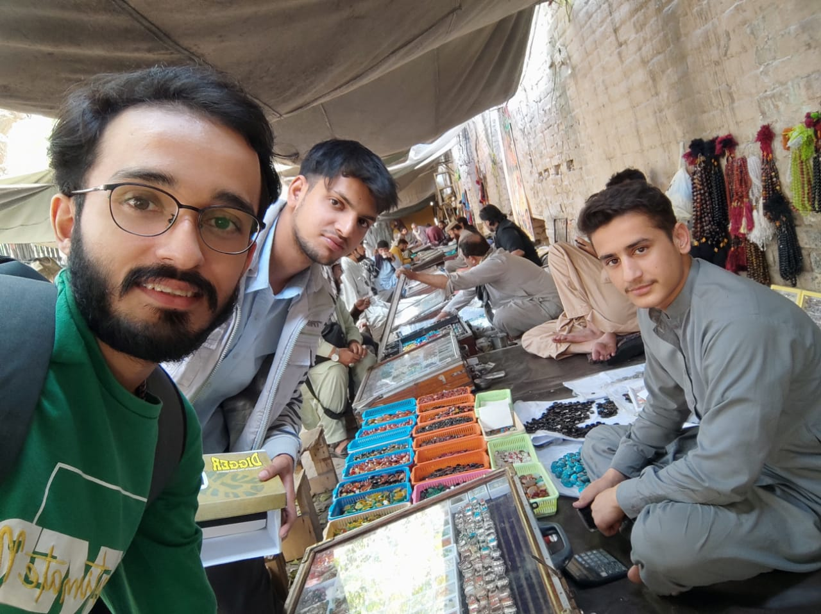
Moments during Market Visits

Slide 17
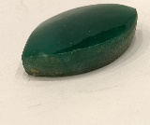
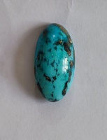
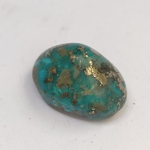
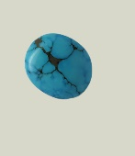
Sample Images
Fake Emerald
Turquoise
Turquoise
Fake Turquoise

Slide 18
Dataset Generation through Website
Real emerald and ruby rare to find
Two website were used for videos collection
Gemrockauction.com
Kuwaitgems.com
Videos were collected
Screenshots were captured of frames
VLC media player used at speed 0.75x
Total 2500 images generated
490 real turquoise
1007 real emerald
1013 Real ruby

Slide 19
Preprocessing
4 preprocessing operation performed
Background Elimination
Flash Effect Removal
Dimension Reduction
Cropping
Adobe Photoshop used for preprocessing

Slide 20
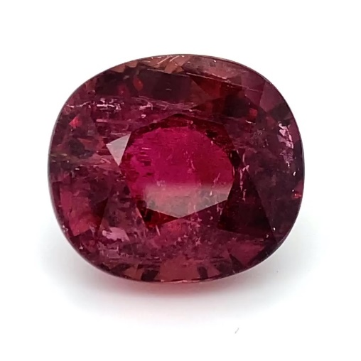
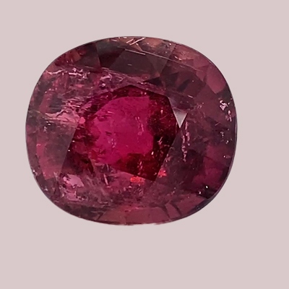
Background Elimination
D8c9c9 color layer used as background
Background
Before Background Elimination
After Background Elimination

Slide 21
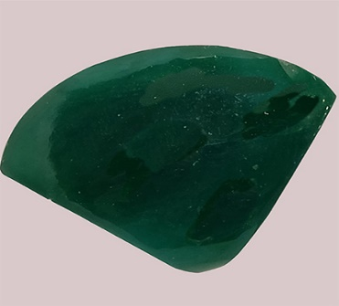
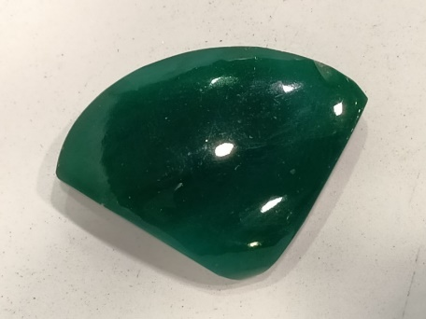
Preprocessing (Contd.) Flash Effect Removal
Extra light power on shops causes reflection on the surface of gemstone despite using environment
Pattern stamp feature used
Before Flash Effect Removal
After Flash Effect Removal

Slide 22
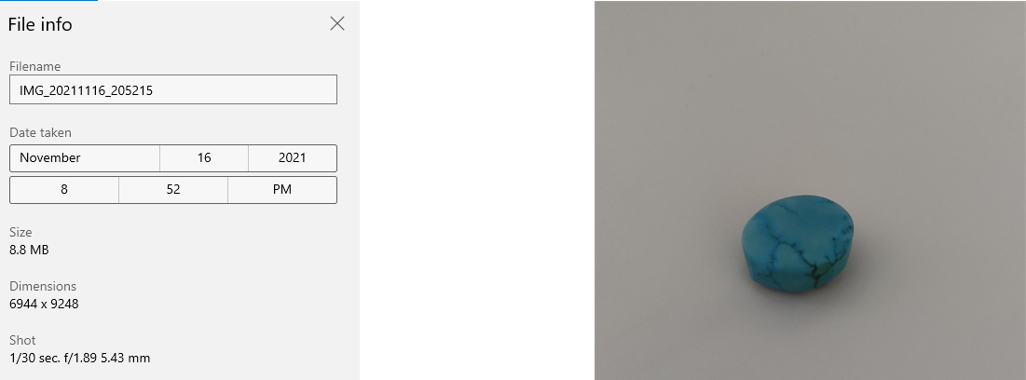
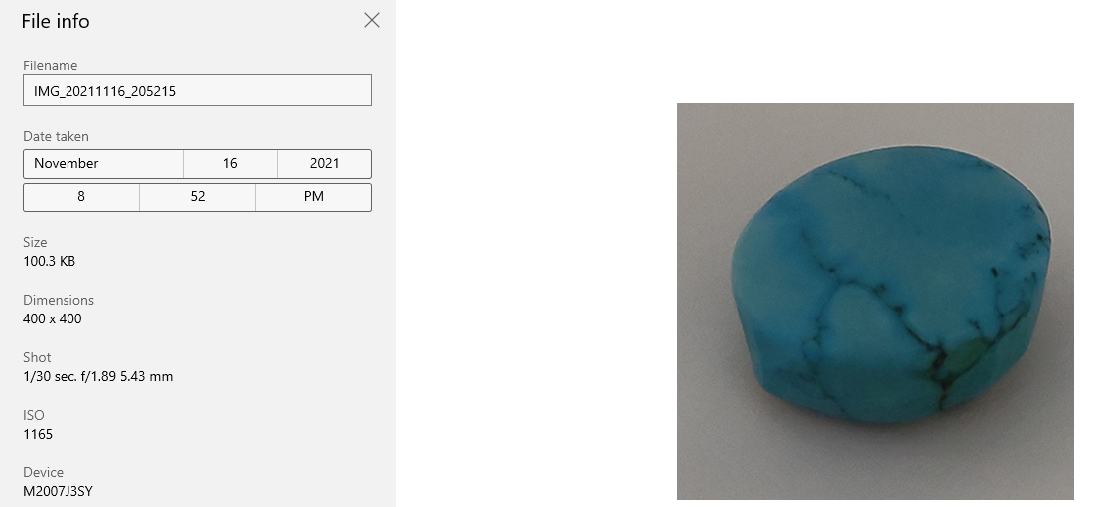
Preprocessing (Contd.) Dimension Reduction& Cropping
Initially size was different
Cropped feature used for dimension reduction
400 x 400 dimension selected
92 pixel per inches
Extra space in the image
Before Dimension Reduction & Cropping
After Dimension Reduction & Cropping

Slide 23
Preprocessing (Contd.) Dataset Distribution
Dataset consist of 6000 images
Dataset is completely balanced
Dataset Category | Multiclass
Number of Classes | 6
Dimension of the dataset | 400,400
Format | JPG
Number of Images | 6000
Images per class | 1000
Colour | RGB
Dimension of Images | 2D
Dataset Size | 236MB
Background Colour | D8c9c9
Gemstone | Fake | Real | Total
Emerald | 1000 | 1000 | 2000
Turquoise | 1000 | 1000 | 2000
Ruby | 1000 | 1000 | 2000
Total | 3000 | 3000 | 6000

Slide 24
Phase 3: Model Design and Validation
Two sub phases
Model Design
Model Verification &validation
Model Design
Model consist of 12 layers
4 Convolution Layer
4 Max Pooling
2 Dense
1 Flatten
1 drop out

Slide 25
Model Architecture
Layer (Type) | Output Shape | Parameters
conv2d (Conv2D) | (None, 398, 398, 32) | 896
max_pooling2d (MaxPooling2D) | (None, 199, 199, 32) | 0
conv2d (Conv2D) | (None, 197, 197, 64) | 18496
max_pooling2d (MaxPooling2D) | (None, 98, 98, 64) | 0
conv2d_2 (Conv2D) | (None, 96, 96, 128) | 73856
max_pooling2d (MaxPooling2D) | (None, 48, 48, 128) | 0
conv2d_2 (Conv2D) | (None, 46, 46, 128) | 147584
max_pooling2d (MaxPooling2D) | (None, 24, 24, 128) | 0
flatten (Flatten) | (None, 67712) | 0
dense (Dense) | (None, 512) | 34669056
Dense_1 (Dense) | (None, 6) | 3078
Total params: 34,912,966
Trainable params: 34,912,966
Non-trainable params: 0

Slide 26
Model Architecture
CL
MP
CL
MP
CL
MP
Tensor
of size 6
CL
MP
DPL
FL
DL
DL
Images
CL – Convolutional Layer
MP – Max Pooling Layer
FL – Flatten Layer
DL – Dense Layer
DPL-Dropout Layer

Slide 27
Model Validation &Verification
Train Validation Test Split
25% of the dataset will be used for validation
50% of the dataset will be used for Train
25% ratio of the dataset will be used for Test
K fold cross validation
5 cv used
Used to avoid Overfitting
* The dataset split ratio is inspired from F. Chollet, “Chapter 5,” in Deep learning with python, Shelter Island (New York, Estados Unidos): Manning, 2018

Slide 28
Train-Validation-Test Split
Gemstone | Fake | Real | Total
Emerald | 500 | 500 | 1000
Turquoise | 500 | 500 | 1000
Ruby | 500 | 500 | 1000
Total | 1500 | 1500 | 3000
Gemstone | Fake | Real | Total
Emerald | 250 | 250 | 500
Turquoise | 250 | 250 | 500
Ruby | 250 | 250 | 1500
Total | 750 | 750 | 1500
Training Images Distribution
Validation and Testing Images Distribution

Slide 29
Phase 4: Application (Proof of concept)
Development Environment –Android Studio
App named Gemo
Main features –Identification, Authentication
Workflow of Gemo
Select Image or Capture Image
Gemstone identifier
Save Result

Slide 30
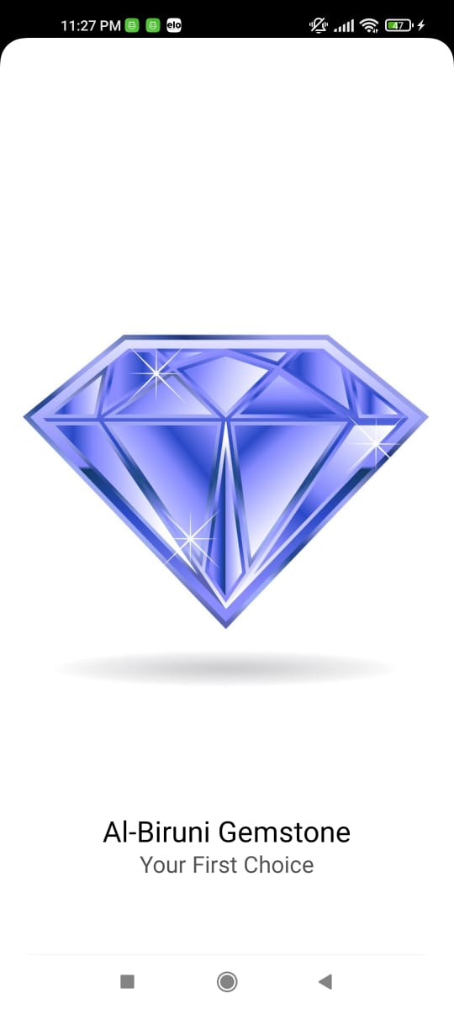
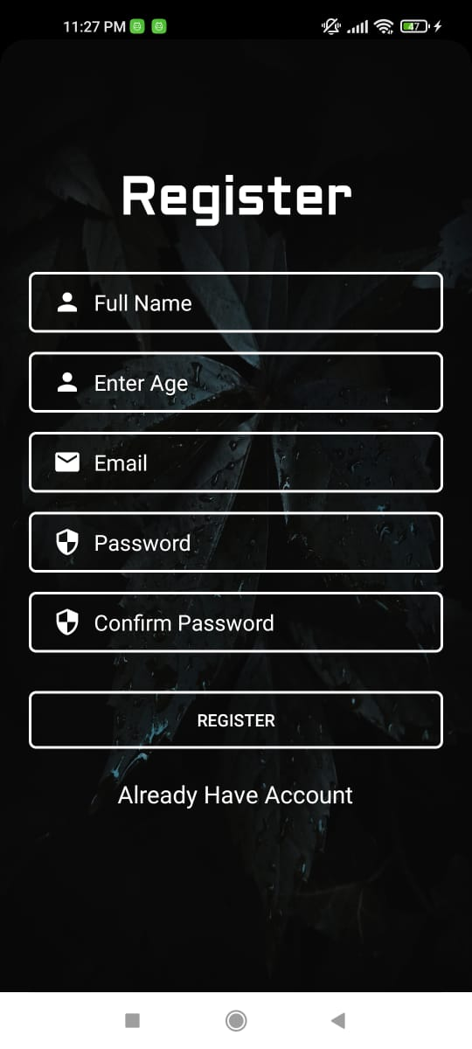
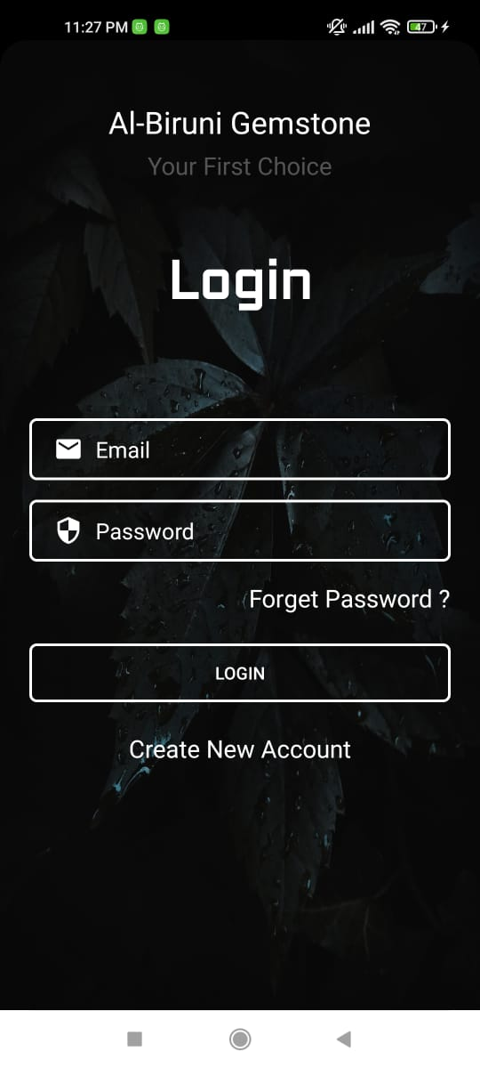
Gemo UI
Splash Screen
Register Screen
Login

Slide 31

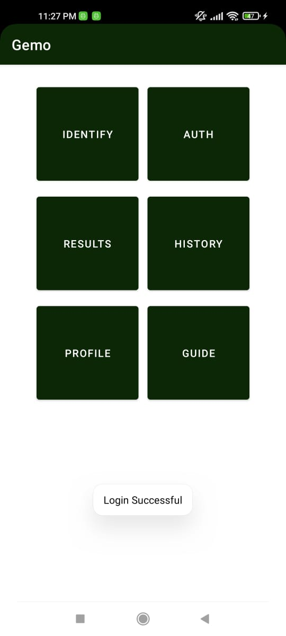
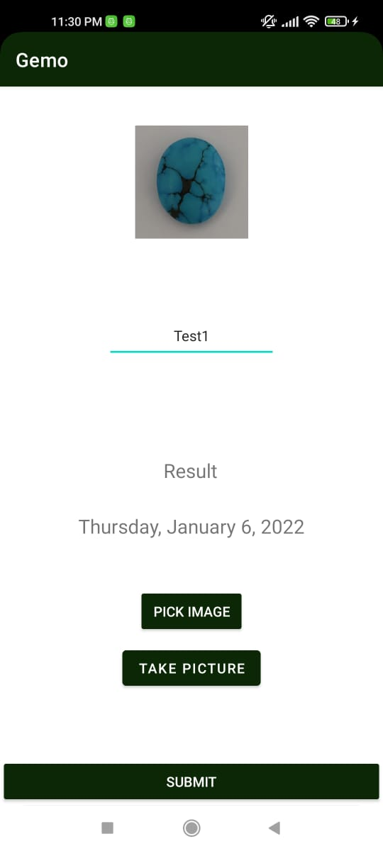
Gemo UI(Contd.)
Forget Password Screen
Dashboard
Identify Screen

Slide 32
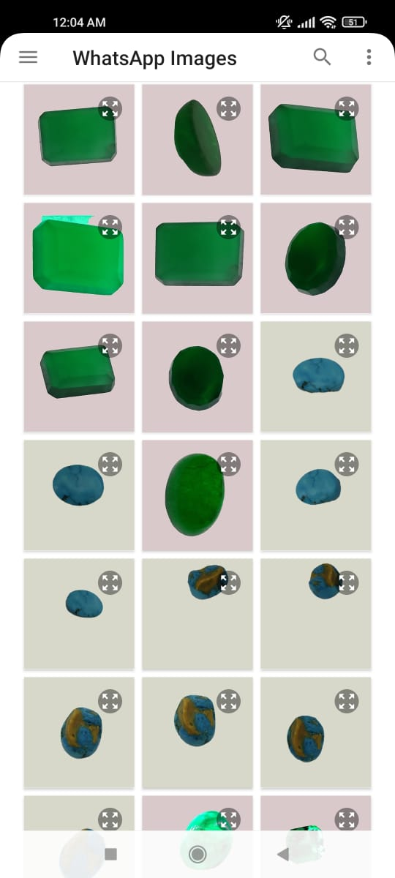
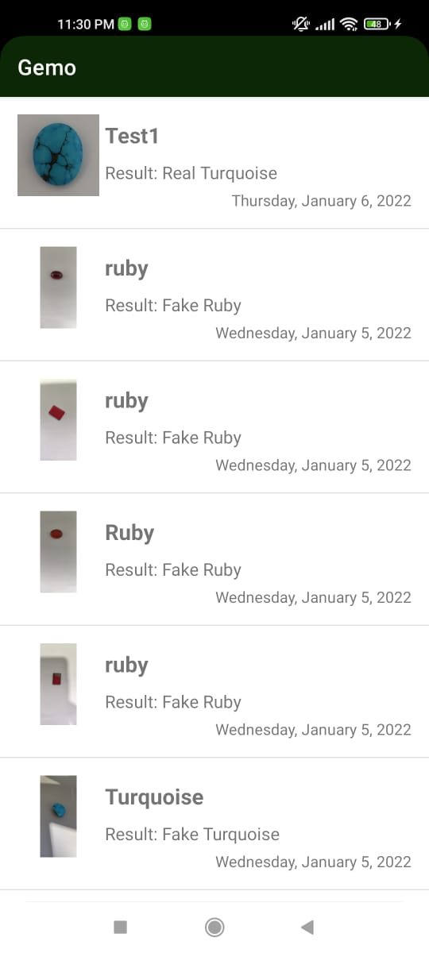
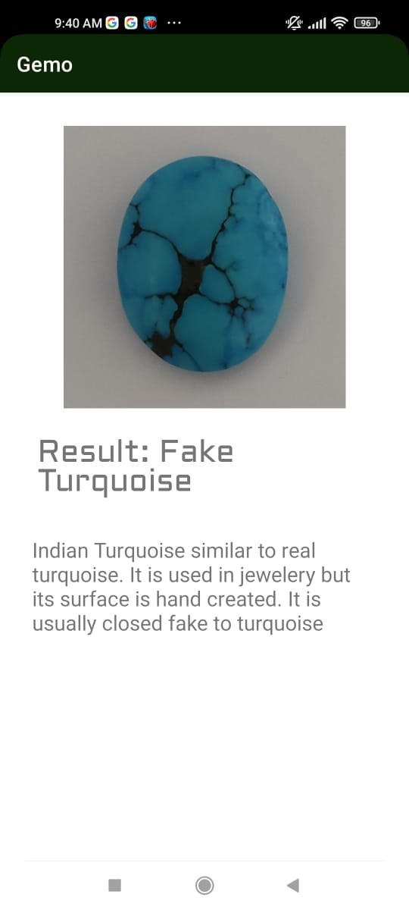
Gemo UI(Contd.)
Select Image
Result Screen
Report Page

Slide 33



Result and Discussion
Environmental setup
Processor: I5
Generation: 6
Ram: 16GB
OS: Window 10
SSD: 256gb
IDE: Jupiter notebook, Google colab pro

Slide 34
Hyper Parameters Tuning
Total 9 Experiments
Hyper-Parameters
Epochs
Batch Size
Learning Rate
Activation Function
Loss Function
Optimizer

Slide 35
Hyper Parameters Tuning
3 Hyper Parameters tunning
Epoch
Learning Rate
Batch Size
Epoch values tunned from 0 to 100
Learning rate values used for experiments are 0.001,0.00025,0.0001
Batch size values were 8,12,16

Slide 36
Pseudocode
For I in learning_rate[0.001,0.0001,0.00025]:
for j in batch_size[8,12,16]:
for k in epoch[0…100]:
Train_Model(I,j,k)

Slide 37
Epoch vs Accuracy
No.of. Epoch | Accuracy | Validation Accuracy | Batch size | Learning rate
10 | 99.01 | 98.03 | 8 | 0.0001
20 | 99.08 | 97.67 | 8 | 0.00025
30 | 99.23 | 97.9 | 8 | 0.00025
40 | 99.20 | 98.13 | 8 | 0.00025
50 | 99.13 | 97.53 | 8 | 0.00025
60 | 99.0 | 97.12 | 8 | 0.00025
70 | 99.17 | 98.65 | 8 | 0.0001
80 | 96.36 | 98.33 | 8 | 0.0001
90 | 99.3 | 97.66 | 8 | 0.00025
100 | 99.5 | 97.86 | 8 | 0.00025

Slide 38
Epoch vs Accuracy

Slide 39
Batch Size vs Accuracy
Batch Size | Accuracy | Validation Accuracy | No.of. Epoch | Learning rate
12 | 99.08 | 97.67 | 20 | 0.00025
16 | 99.13 | 93.0 | 20 | 0.001
8 | 99.17 | 98.65 | 70 | 0.0001

Slide 40
Batch Size vs Accuracy
Epochs = 70 , Batch Size = 8 , Learning Rate = 0.0001. Training Accuracy = 99.17,Validartion Accuracy=98..65

Slide 41
Learning Rate vs Accuracy
Learning Rate | Accuracy | Validation Accuracy | No.of.Epoch | Batch Size
0.001 | 93.01 | 91.03 | 20 | 8
0.00025 | 99.20 | 98.13 | 20 | 8
0.0001 | 99.17 | 98.65 | 70 | 8

Slide 42
Learning Rate vs Accuracy
Epochs = 70 , Batch Size = 8 , Learning Rate = 0.0001, Training Accuracy = 99.17,Validartion Accuracy=98..65

Slide 43
Proposed model
No. of Epochs | Learning Rate | Batch Size | Accuracy | Validation Accuracy | Loss Function | Testing Accuracy
70 | 0.0001 | 8 | 99.17 | 98.65 | 0.2597 | 95.000

Slide 44
Conclusion and Future Work
More dataset
Pre-trained model
Deployment of model
More hyperparameter tuning

Slide 45
Achievements
Objectives | Achievements
Create a Benchmark Dataset | A dataset of 6000 images generated
To Design Model for identification of gemstone | A model is designed that can identify 3 types of gemstones
To design a model that authenticate real or Fake gemstone | A model is designed that can authenticate between three types of real or fake gemstone namely{Emerald,Ruby,Turquoise}
To design a model with accuracy more than 90% | Model is designed with the accuracy of 95%

Slide 46
Demos

Slide 47
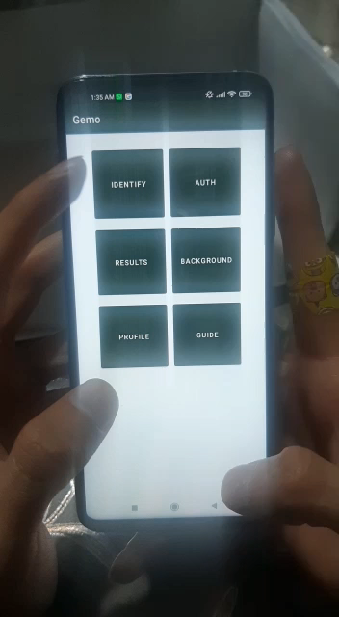
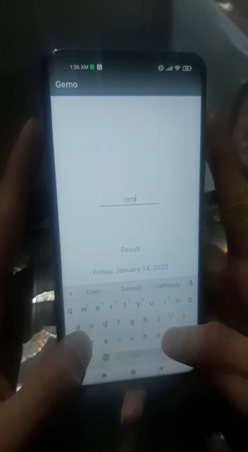
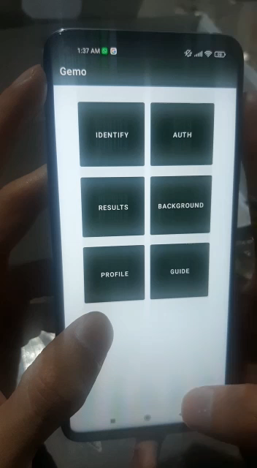
Real Turquoise Real Ruby Real Emerald

Slide 48
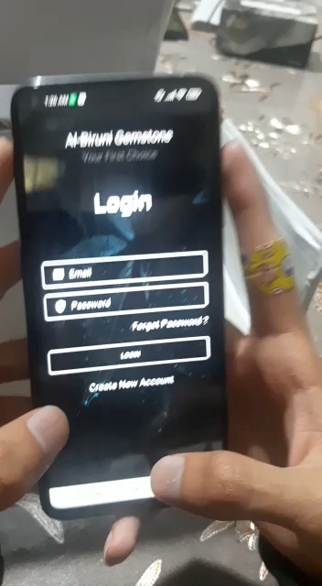
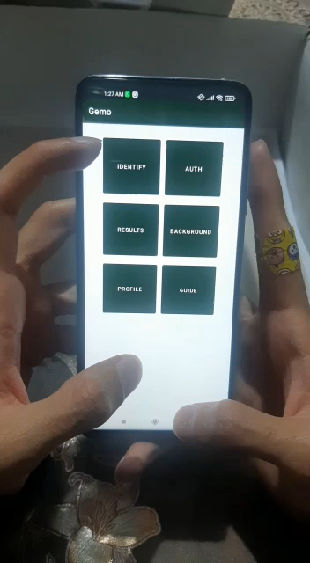
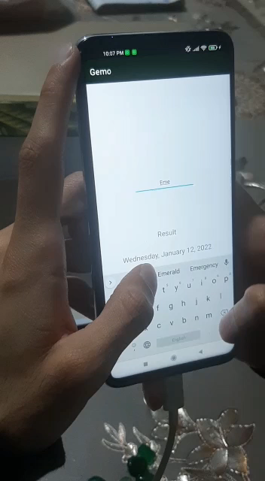
Fake Turquoise Fake Ruby Fake Emerald

Slide 49
References
[1] “Strategic Plan for Pakistan ’ s Gems and Jewelry Industry,” 2006.
[2] L. Leon-Reina, J. M. Compana, Á. G. De la Torre, R. Moreno, L. E. Ochando, and M. A. G. Aranda, “Powder diffraction analysis of gemstone inclusions,” Powder Diffraction, vol. 26, no. 1, pp. 48–52, 2011, doi: 10.1154/1.3552672.
[3] W. Aizuddin, W. Razali, N. Atiqah, B. Baharudeen, F. Najihah, and B. Mat, “Gemstone identification using fluorescence technique,” vol. 3, no. September, pp. 73–78, 2020.
[4] J. Jehlička, A. Culka, M. Baštová, P. Bašta, and J. Kuntos, “The Ring Monstrance from the Loreto treasury in Prague: Handheld Raman spectrometer for identification of gemstones,” Philosophical Transactions of the Royal Society A: Mathematical, Physical and Engineering Sciences, vol. 374, no. 2082, 2016, doi: 10.1098/rsta.2016.0042.
[5] S. Saeseaw, N. D. Renfro, A. C. Palke, Z. Sun, and S. F. McClure, “Geographic origin determination of emerald,” Gems and Gemology, vol. 55, no. 4, pp. 614–646, 2019, doi: 10.5741/GEMS.55.4.614.
[6] E. Fritsch and C. M. Stockton, “Infrared spectroscopy in gem identification.,” Gems & Gemology, vol. 23, no. Spring, pp. 18–26, 1987, doi: 10.5741/gems.23.1.18.
[7] L. Leon-Reina, J. M. Compana, Á. G. De la Torre, R. Moreno, L. E. Ochando, and M. A. G. Aranda, “Powder diffraction analysis of gemstone inclusions,” Powder Diffraction, vol. 26, no. 1, pp. 48–52, 2011, doi: 10.1154/1.3552672.
[8] W. Aizuddin, W. Razali, N. Atiqah, B. Baharudeen, F. Najihah, and B. Mat, “Gemstone identification using fluorescence technique,” vol. 3, no. September, pp. 73–78, 2020.

Slide 50
References
[10] Type Identification System Based on HSV Space Colour Using an Artificial Neural Network Back Propagation Algorithm,” vol. 149, no. Icosat 2017, pp. 104–109, 2018, doi: 10.2991/icosat-17.2018.24.
[10] A. Ostreika, M. Pivoras, A. Misevičius, T. Skersys, and L. Paulauskas, “Classification of objects by shape applied to amber gemstone classification,” Applied Sciences (Switzerland), vol. 11, no. 3, pp. 1–14, 2021, doi: 10.3390/app11031024.
[11] J. T. Qiu, L. Qiu, and H. X. Mu, “Feasibility of gem identification using reflectance spectra coupled with artificial intelligence,” Spectroscopy Letters, vol. 52, no. 9, pp. 520–532, 2019, doi: 10.1080/00387010.2019.1671873.
[12] S. Sinkevicius, A. Lipnickas, and K. Rimkus, “Amber gemstones sorting by colour,” Elektronika ir Elektrotechnika, vol. 23, no. 2, pp. 10–14, 2017, doi: 10.5755/j01.eie.23.2.17993.
[13] D. Wang, L. Bischof, R. Lagerstrom, V. Hilsenstein, A. Hornabrook, and G. Hornabrook, “Automated Opal Grading by Imaging and Statistical Learning,” IEEE Transactions on Systems, Man, and Cybernetics: Systems, vol. 46, no. 2, pp. 185–201, 2016, doi: 10.1109/TSMC.2015.2427776.
[14] S. Sinkevicius, A. Lipnickas, and K. Rimkus, “Multiclass amber gemstones classification with various segmentation and committee strategies,” Proceedings of the 2013 IEEE 7th International Conference on Intelligent Data Acquisition and Advanced Computing Systems, IDAACS 2013, vol. 1, no. September, pp. 304–308, 2013, doi: 10.1109/IDAACS.2013.6662694.
[15] “Machine Learning: What it is and why it matters | SAS.” https://www.sas.com/en_us/insights/analytics/machine-learning.html#:~:text=Machine learning is a method,decisions with minimal human intervention. (accessed April 3, 2021) (accessed Jun. 25, 2021).
[16] “Emerald. [Online]. Available: https://www.kuwaitgems.com/emerald/. [Accessed: 26-Dec-2021].” https://www.kuwaitgems.com/emerald/ (accessed Dec. 27, 2021).
[17] “‘Gem auctions online - verified gemstone dealers - gemstones for sale,’ Gem Rock Auctions. [Online]. Available: https://www.gemrockauctions.com/. [Accessed: 26-Dec-2021].” https://www.gemrockauctions.com/ (accessed Dec. 27, 2021).
[18] F. Chollet, M A N N I N G.

Slide 51
Al-Biruni Gemstones Authenticator
Thanks
Please feel free to:
Ask any further details
Advise any improvements
FYP Defense Presentation By BSCS-S21-001
03-134181-008 | Jibran Ali
03-134181-021 | Muhammad Muzamil Rashid

Slide 52
Experiment #1
Epoch | Batch size | Learning rate | Accuracy | Validation Accuracy
10 | 16 | 0.0001 | 96.24 | 87.24
20 | 16 | 0.0001 | 99.13 | 93.0
30 | 16 | 0.0001 | 98.02 | 91.24
40 | 16 | 0.0001 | 99.42 | 93.42
50 | 16 | 0.0001 | 99.73 | 89.65
60 | 16 | 0.0001 | 98.40 | 90.6
70 | 16 | 0.0001 | 100 | 89.50
80 | 16 | 0.0001 | 95.73 | 82.33
90 | 16 | 0.0001 | 89.8 | 75
100 | 16 | 0.0001 | 99.73 | 88.71

Slide 53
Experiment #2
Epoch | Batch size | Learning rate | Accuracy | Validation Accuracy
10 | 16 | 0.001 | 72.89 | 81.9
20 | 16 | 0.001 | 76.88 | 74.6
30 | 16 | 0.001 | 82.0 | 69.62
40 | 16 | 0.001 | 88.2 | 68.8
50 | 16 | 0.001 | 93.5 | 82.9
60 | 16 | 0.001 | 89.8 | 72.2
70 | 16 | 0.001 | 93.0 | 72.0
80 | 16 | 0.001 | 94.9 | 67.8
90 | 16 | 0.001 | 97.5 | 70.9
100 | 16 | 0.001 | 95.1 | 72.2

Slide 54
Experiment #3
Epoch | Batch size | Learning rate | Accuracy | Validation Accuracy
10 | 16 | 0.00025 | 90 | 46
20 | 16 | 0.0025 | 98.3 | 82.7
30 | 16 | 0.00025 | 97 | 89.8
40 | 16 | 0.00025 | 97.6 | 74.8
50 | 16 | 0.00025 | 93.0 | 64.31
60 | 16 | 0.00025 | 99.4 | 90.0
70 | 16 | 0.00025 | 95.7 | 88.0
80 | 16 | 0.00025 | 99.4 | 78.6
90 | 16 | 0.00025 | 98.6 | 85.0
100 | 16 | 0.00025 | 99.20 | 81.2

Slide 55
Experiment #4
Epoch | Batch size | Learning rate | Accuracy | Validation Accuracy
10 | 8 | 0.0001 | 99.01 | 98.03
20 | 8 | 0.0001 | 97.08 | 83.67
30 | 8 | 0.0001 | 98.23 | 93.9
40 | 8 | 0.0001 | 98.92 | 95.48
50 | 8 | 0.0001 | 99.05 | 96.6
60 | 8 | 0.0001 | 98.82 | 95.07
70 | 8 | 0.0001 | 99.13 | 98.65
80 | 8 | 0.0001 | 96.36 | 98.33
90 | 8 | 0.0001 | 98.71 | 95.24
100 | 8 | 0.0001 | 98.28 | 97.24

Slide 56
Experiment #5
Epoch | Batch size | Learning rate | Accuracy | Validation Accuracy
10 | 8 | 0.001 | 93.01 | 91.03
20 | 8 | 0.001 | 95.08 | 82.67
30 | 8 | 0.001 | 97.23 | 85.9
40 | 8 | 0.001 | 97.92 | 87.48
50 | 8 | 0.001 | 97.05 | 81.6
60 | 8 | 0.001 | 98.9 | 76.1
70 | 8 | 0.001 | 96.1 | 79.6
80 | 8 | 0.001 | 97.6 | 85.9
90 | 8 | 0.001 | 99.3 | 87.15
100 | 8 | 0.001 | 99.13 | 84.3

Slide 57
Experiment #6
Epoch | Batch size | Learning rate | Accuracy | Validation Accuracy
10 | 8 | 0.00025 | 98.01 | 96.03
20 | 8 | 0.00025 | 99.08 | 97.67
30 | 8 | 0.00025 | 99.23 | 97.9
40 | 8 | 0.00025 | 99.20 | 98.13
50 | 8 | 0.00025 | 99.13 | 97.53
60 | 8 | 0.00025 | 99.0 | 97.12
70 | 8 | 0.00025 | 98.65 | 94.9
80 | 8 | 0.00025 | 97.7 | 92.01
90 | 8 | 0.00025 | 99.3 | 97.66
100 | 8 | 0.00025 | 99.5 | 97.86

Slide 58
Experiment #6
Epoch | Batch size | Learning rate | Accuracy | Validation Accuracy
10 | 8 | 0.00025 | 98.01 | 96.03
20 | 8 | 0.00025 | 99.08 | 97.67
30 | 8 | 0.00025 | 99.23 | 97.9
40 | 8 | 0.00025 | 99.20 | 98.13
50 | 8 | 0.00025 | 99.13 | 97.53
60 | 8 | 0.00025 | 99.0 | 97.12
70 | 8 | 0.00025 | 98.65 | 94.9
80 | 8 | 0.00025 | 97.7 | 92.01
90 | 8 | 0.00025 | 99.3 | 97.66
100 | 8 | 0.00025 | 99.5 | 97.86

Slide 59
Experiment #7
Epoch | Batch size | Learning rate | Accuracy | Validation Accuracy
10 | 12 | 0.00025 | 0.9827 | 0.9760
20 | 12 | 0.00025 | 0.9953 | 0.9767
30 | 12 | 0.00025 | 0.9947 | 0.9667
40 | 12 | 0.00025 | 0.9953 | 0.9740
50 | 12 | 0.00025 | 0.9983 | 0.9707
60 | 12 | 0.00025 | 0.9933 | 0.9793
70 | 12 | 0.00025 | 0.9987 | 0.9787
80 | 12 | 0.00025 | 0.9897 | 0.9713
90 | 12 | 0.00025 | 1.0000 | 0.9733
100 | 12 | 0.00025 | 1.0000 | 0.9660

Slide 60
Experiment #8
Epoch | Batch size | Learning rate | Accuracy | Validation Accuracy
10 | 12 | 0.0001 | 0.9807 | 0.9327
20 | 12 | 0.0001 | 0.9910 | 0.9707
30 | 12 | 0.0001 | 0.9960 | 0.9633
40 | 12 | 0.0001 | 0.9990 | 0.9767
50 | 12 | 0.0001 | 0.9993 | 0.9733
60 | 12 | 0.0001 | 0.9977 | 0.9767
70 | 12 | 0.0001 | 0.9930 | 0.9780
80 | 12 | 0.0001 | 0.9927 | 0.9760
90 | 12 | 0.0001 | 0.9977 | 0.9700
100 | 12 | 0.0001 | 0.9990 | 0.9753

Slide 61
Experiment #9
Epoch | Batch size | Learning rate | Accuracy | Validation Accuracy
10 | 12 | 0.001 | 0.9413 | 0.8860
20 | 12 | 0.001 | 0.9553 | 0.9033
30 | 12 | 0.001 | 0.9630 | 0.8647
40 | 12 | 0.001 | 0.9747 | 0.9013
50 | 12 | 0.001 | 0.9840 | 0.9107
60 | 12 | 0.001 | 0.9740 | 0.9380
70 | 12 | 0.001 | 0.9783 | 0.9440
80 | 12 | 0.001 | 0.9857 | 0.9467
90 | 12 | 0.001 | 0.9903 | 0.9300
100 | 12 | 0.001 | 0.9770 | 0.9307

